Slide 1
Scrum Overview
Prof. Dr. Dirk Riehle
Friedrich-Alexander University Erlangen-Nürnberg
AMOS C02
Licensed under CC BY 4.0 International
Notes:
It is Friedrich-Alexander University Erlangen-Nürnberg – FAU, in short.
Corporate identity wants us to say “Friedrich-Alexander University”.

Slide 2
Agenda
Scrum overview
Product owner
Software developer
Scrum master
Core activities

Slide 3
Process and Technical Practices
Scrum
(for process practices)
XP
(for technical practices)

Slide 4
1. Scrum Overview

Slide 5
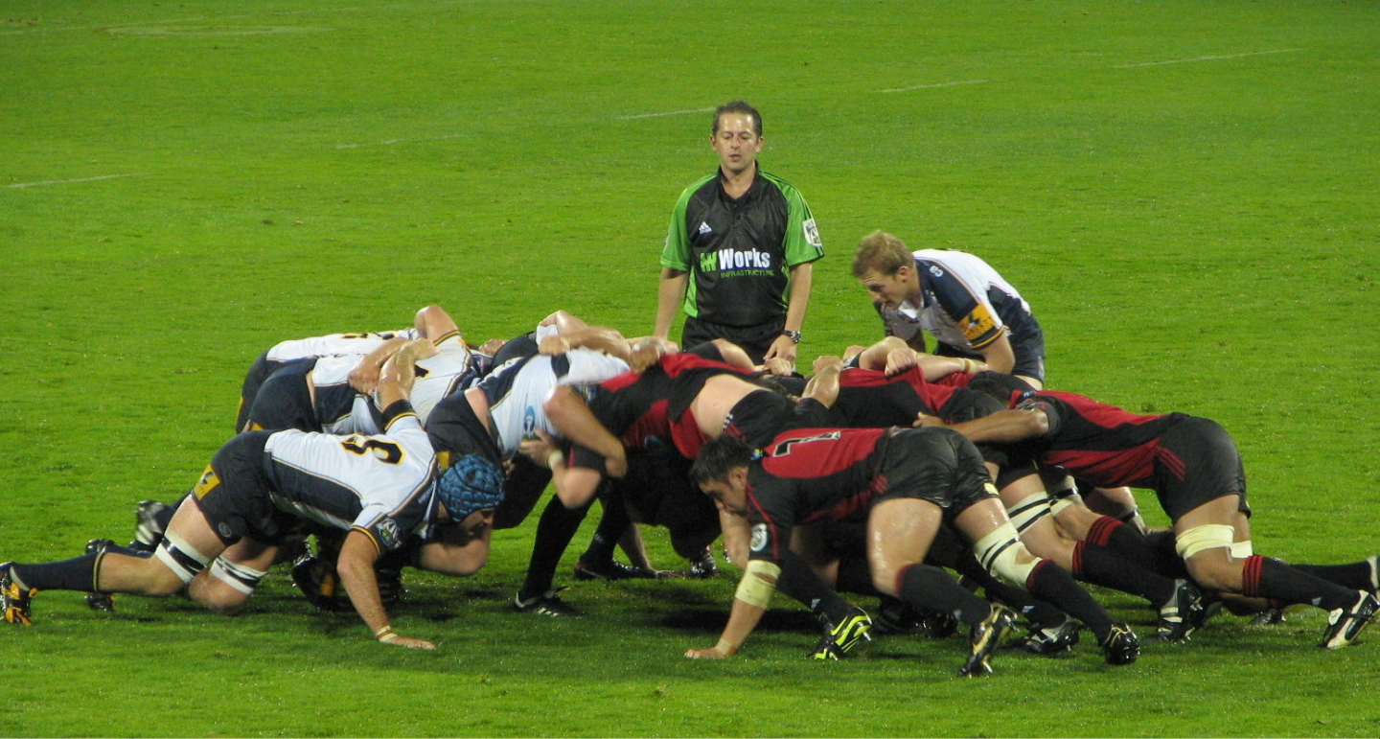
Scrum Definition 1 / 2
An agile method, invented around 1993, 1995
A rugby situation requiring intense collaboration

Slide 6
Scrum Definition 2 / 2 [S04] [C06]
A (minimal) agile process model
Independent of software development
Where definitions sometimes vary (two fathers)

Slide 7
Scrum Process Scope
Portfolio
Product
Release
Sprint
Day

Slide 8
Scrum Process Overview
Rel. m-1
Rel. m
Rel. m+1
...
6-12 months
6-12 months
6-12 months
time
Sprint n-1
Sprint n
Sprint n+1
...
...
P
E
3R
P
E
3R
P
E
3R
P: Planning
E: Execution
3R: Review, release, and retrospective
1-4 weeks
1-4 weeks
1-4 weeks
time

Slide 9
Scrum Roles, Practices, and Artifacts
Roles
Product owner
Software developer [1]
Scrum master
PO
Sprint planning
Daily Scrum
Sprint review
Release planning
…
Practices
Perform
Daily
Scrum
Artifacts
Product backlog
Sprint backlog
Burn-down chart
...
Product
Backlog
[1] Originally “team members”

Slide 10
Scrum Roles and Responsibilities
Product
Owner
PO
Software
Developer
SD
SM
Scrum
Master

Slide 11
Committed vs. Involved (Scrum Lore)
Committed
  Product owner
  Software developer
  Scrum master
Involved
  Customer
  Marketing manager
  Sponsor / funder
  Others ...

Slide 12
2. Product Owner

Slide 13
Product Owner
Holds overall responsibility for the product being developed
Provides
  product vision,
  product requirements
Plans and helps plan development
Tracks progress

Slide 14
Product Owner Responsibilities
Opportunity Assessment
Product Specification
Development Planning
Progress Tracking

Slide 15
Traditional to Scrum Role Mapping (Recap)
Traditional
Scrum
Product Manager
Product Owner
Engineering Manager
Software Developer
Software Developer
Scrum Master
QA Engineer

Slide 16
Product Owner Processes and Artifacts
Processes | Artifacts
Opportunity Assessment | Product Vision
Product Specification | Product Glossary Product Backlog Feature Archive
Product Planning | Sprint Backlog Release Plan
Progress Tracking | Burn-down Charts Feature Archive

Slide 17
Traditional vs. Scrum Product Management
Scrum is a framework and thus typically enhanced with other roles and responsibilities
Traditional Product Manager
  Product manager is responsible for product
  strategy and specification
  Product manager does not interfere with
  detail development planning
  Product Manager is frequently high-level,
  delegates product decisions to engineering
The Scrum product owner mostly matches the technical product manager [1]
Scrum Product Owner
  Product owner is also responsible for product strategy and specification
  Product owner shoulders some of the engineering manager role
  Product owner is very much in the details of planning and tracking development
[1] https://dirkriehle.com/2018/05/23/product-manager-vs-product-owner/

Slide 18
3. Software Developer

Slide 19
Software Development Team
Holds overall responsibility for delivering working software
  That provides the features the team committed to delivering

Slide 20
Software Developer Responsibilities
Architecture Definition
Feature Implementation
Size Estimation
Sprint Commitment

Slide 21
Traditional to Scrum Role Mapping (Recap)
Traditional
Scrum
Product Manager
Product Owner
Engineering Manager
Software Developer
Software Developer
Scrum Master
QA Engineer

Slide 22
Software Developer Processes and Artifacts
Processes | Artifacts
Development Planning | Sprint Backlog
Software Development | Software
Quality Assurance | Software

Slide 23
4. Scrum Master

Slide 24
Scrum Master
Holds overall responsibility for
  Removing non-technical obstacles from the project’s path

Slide 25
Traditional to Scrum Role Mapping (Recap)
Traditional
Scrum
Product Manager
Product Owner
Engineering Manager
Software Developer
Software Developer
Scrum Master
QA Engineer

Slide 26
Scrum Master Processes and Artifacts
Processes | Artifacts
Process Facilitiation | Impediment Backlog
Process Improvement | Impediment Backlog

Slide 27
Line Reporting (vs. Roles)
PM
PM
EM
SD
SD
SD
SD
...
SD
SD
PM Product Manager
EM Engineering Manager
SD Software Developer

Slide 28
5. Core Activities

Slide 29
Scrum Sprints (Iteration)
A sprint is Scrum's iteration; it is an equal-length time-box
It is a highly structured process with defined feedback points
...
P
E
3R
...
P: Planning
E: Execution
3R: Review, release, and retrospective
time

Slide 30
Sprint Structure
Wed
Thu
Mon
Tue
09:00
Sprint
planning
Daily Scrum
Daily Scrum
Daily Scrum
...
Product management
Software development
Process improvement
Product management
Software development
Process improvement
Product management
Software development
Process improvement
Product management
Software development
Process improvement
Review
13:00
Next sprint
preparation
Release
Retrospective
17:00

Slide 31
Main Work Streams of Sprints
Product management
(Product owner)
Software development
(Software developer)
Process improvement
(Scrum master)

Slide 32
Sprint Planning
Definition
  Serves to plan the upcoming sprint’s work
  Involves product owner, software developers, and Scrum master
  Results in sprint backlog containing the upcoming sprint’s work
Activities
  Product owner
    The product owner provides the prioritized list of features
  Software developer
    The software developers estimate feature size using planning poker
    Features keep being added to sprint backlog until there is enough work
    Software developers breakdown features into tasks, distribute them
  Scrum master
    Observes team dynamics

Slide 33
Sprint Execution
Definition
  Serves to evolve product
Activities
  Product owner
    Answers developer questions about features
    Evolves product backlog, updates release plan
  Software developer
    Implement features from sprint backlog
    Interact with product owner to refine feature specifications
  Scrum master
    Learns about process impediments
    Tries to fix those impediments

Slide 34
Next Sprint Preparation
Definition
  Serves to prepare the upcoming sprint planning meeting
  Involves product owner and at least one software developer
  Results in sufficiently comprehensive product backlog
Activities
  Product owner
    The product owner provides the prioritized list of features
    Includes high-priority bug reports as backlog entries
  Software developer
    Provides size estimates for highly prioritized features
    Adds refactorings for planning consideration

Slide 35
Sprint Review, Release, and Retrospective
Definition
  Sprint review
    Product owner reviews results
    Team signs off on finished features
  Sprint release
    Stakeholders sign off
    If so, product is released
  Sprint retrospective
    Team reviews process
    Developers commit to improvements

Slide 36
Summary
Scrum overview
Product owner
Software developer
Scrum master
Core activities

Slide 37
Thank you! Questions?
dirk.riehle@fau.de – https://oss.cs.fau.dedirk@riehle.org – https://dirkriehle.com – @dirkriehle
DR

Slide 38
Legal Notices
License
  Licensed under the CC BY 4.0 International license
Copyright
  © 2010-2022 Dirk Riehle, some rights reserved

